Slide 1
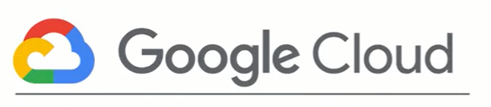
Notes:
Today, I will tell you Google Cloud Platform in terms of Data Scientist or Data Engineer.

Slide 2
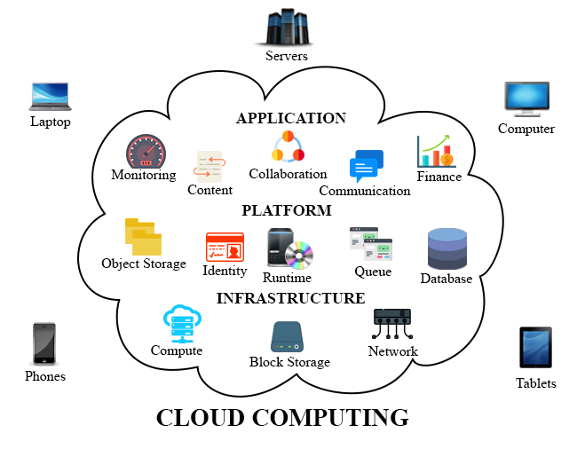
What is Cloud Computing?
Notes:
Instead of buying, owning and maintaining physical data centers and servers, you can access technology services such as computing power, storage, and databases from cloud provider. If you are a member of a cloud platform, you don’t need to have special hardware or software program on your computer to write code, you have to be accessing internet. Cloud computer have already everything you need.

Slide 3
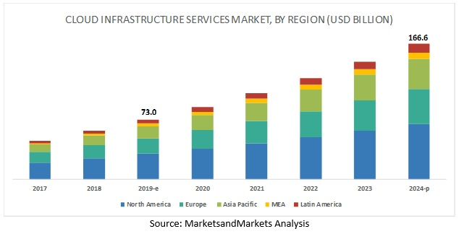
Notes:
Hundreds of billions dollars is allocated to the clouds by companies and those numbers are only expected to increase on the coming years.

Slide 4
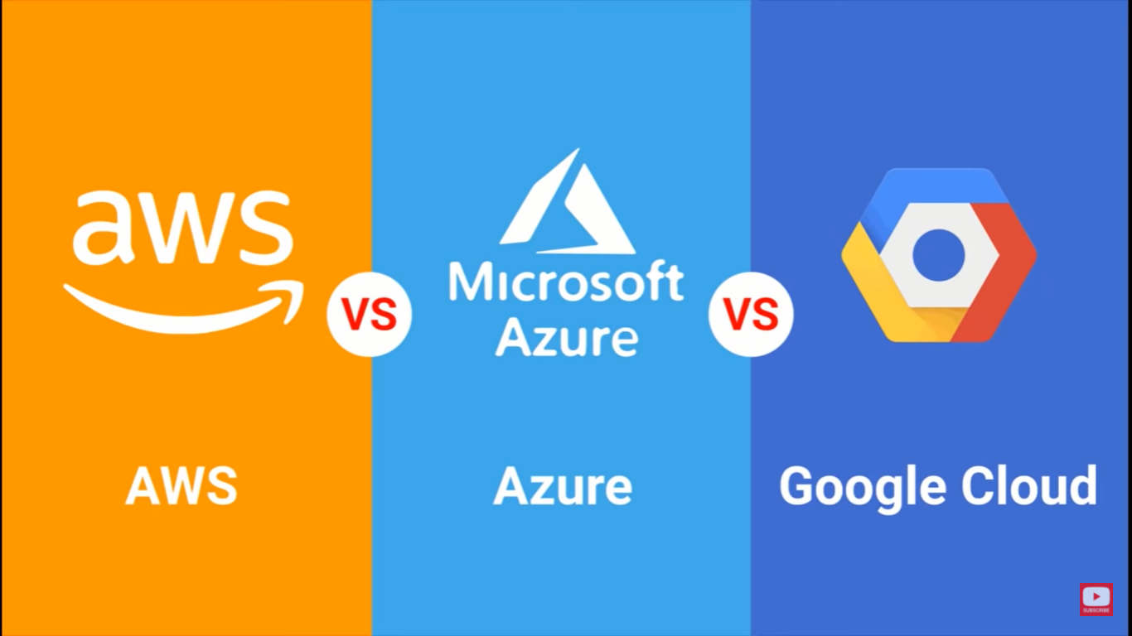
Notes:
The most common Cloud Platforms are AWS (Amazon Web Services), Microsoft Azure, Google Cloud Platform. Software development and testing, big data analytics, web application. What can you do with Cloud Computing. You can build nearly anything you can imagine from infrastructure sevices such as compute, storage and databases to machine learning, data analytics much more.

Slide 5
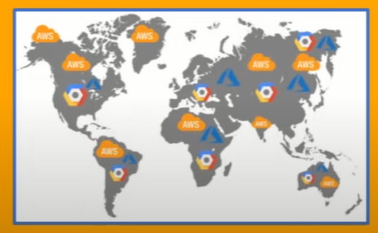
Notes:
These company have a lot of data centers and servers all around the world. They have similar services and Today, I will tell you Google Cloud Platform.

Slide 6
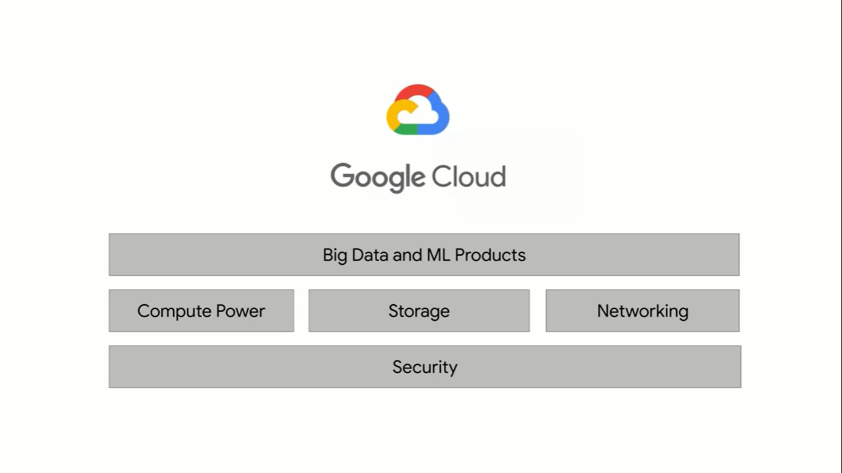
What can you do with Cloud Computing
Notes:
There are three fundamental aspects of Google's core infrastructure and a top layer of products and services that we will interact with most often.
The base layer that covers all of Google's applications and therefore Google Cloud's too, is security. On top of that, are compute, storage, and networking.
These allow you to process, store, and deliver business changing insights, data pipelines, and machine learning models. Finally, while running your big data applications
on bare metal virtual machines as possible, Google has developed a top layer of big data and ML products to abstract away a lot of the hard work of managing and scaling that infrastructure for you.

Slide 7
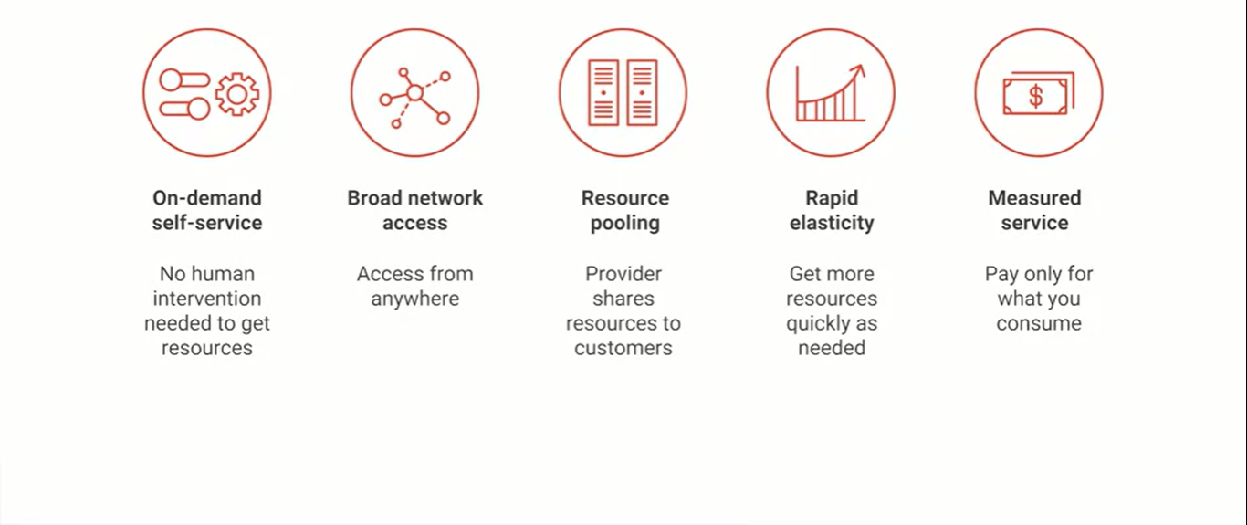
Advantages of Cloud Computing
Notes:
First, you get computing resources on-demand and self-service. All you have to do is use a simple interface and you get the processing power, storage, and network you need, with no need for human intervention.
Second, you access these resources over the net from anywhere you want.
Third, the provider of those resources has a big pool of them and allocates them to customers out of that pool. That allows the provider to get economies of scale by buying in bulk and pass the savings on to the customers. Customers don't have to know or care about the exact physical location of those resources.
Fourth, the resources are elastic. If you need more resources you can get more, rapidly. If you need less, you can scale back.
And last, the customers pay only for what they use or reserve as they go. If they stop using resources, they stop paying. That's it. That's the definition of cloud.

Slide 8
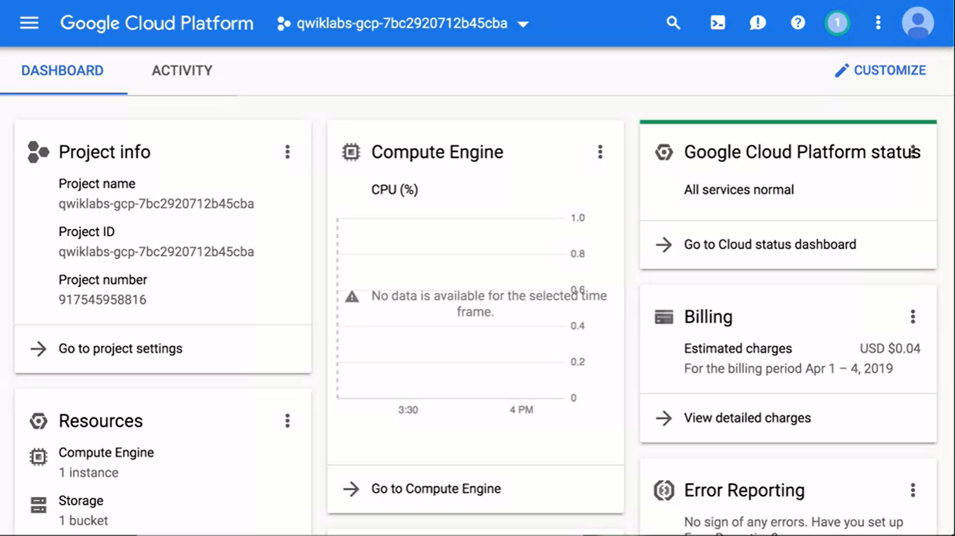
Notes:
This screen is dashboard of the GCP.

Slide 9
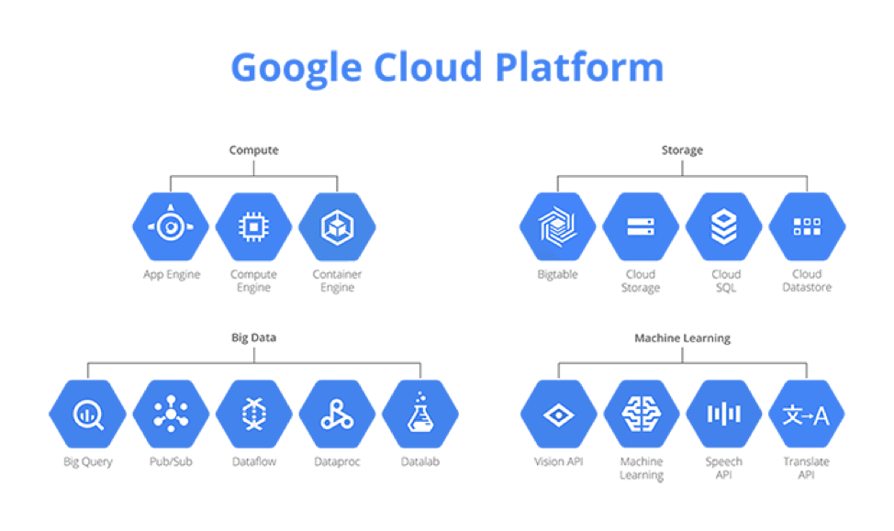
Notes:
The suite of big data products on Google Cloud Platform

Slide 10
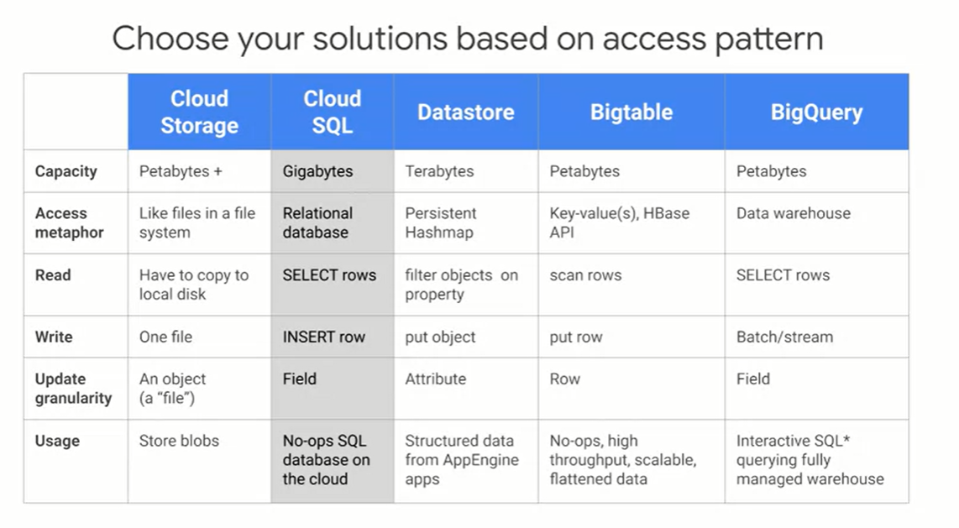
Notes:
Storages are explained in the table according to their intended use.

Slide 11
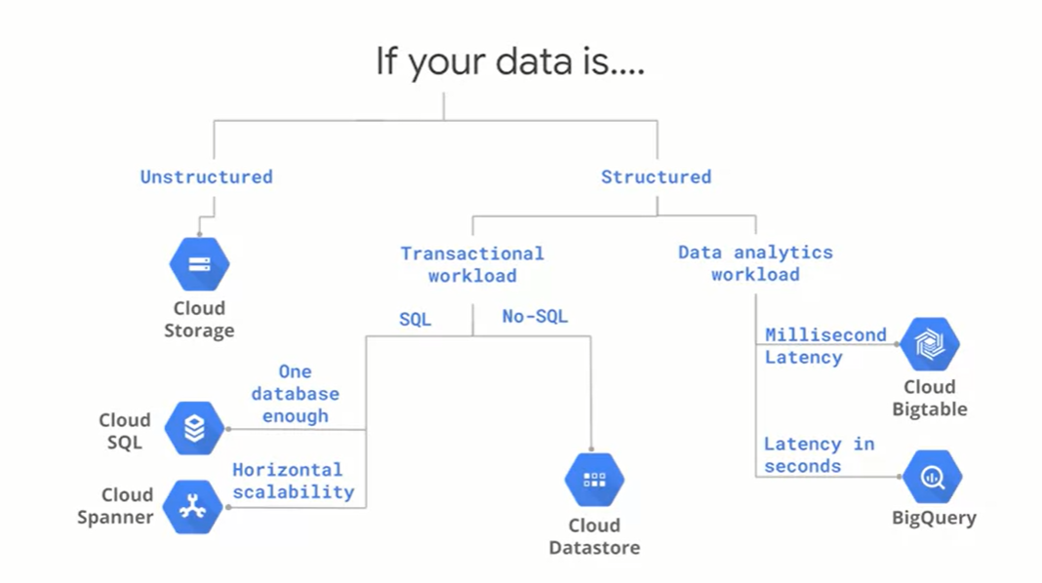
Notes:
you'll be trying to search for data based on a single key, use Datastore if you'd be finding data using SQL use Cloud SQL.
if you wanted transactional database that is horizontally scalable so that you can deal with data larger than a few gigabytes, or if you need multiple databases so you want them spread globally use Cloud Spanner. If you'll need multiple databases, either because you have a lot of data or because your application needs to be transactional across different continents, use Cloud Spanner.
Use Bigtable if you need real-time high-throughput applications.
For our housing recommendation use case, we want to store our ratings and predictions somewhere. This is a structured dataset of user ratings and houses. It's built for a transactional workload, writes and reads, and one database is enough for a small dataset and hence we pick Cloud SQL.
what's Cloud SQL? It's a Google-hosted and managed relational database in the Cloud. Cloud SQL supports two open-source databases: MySQL and Postgres, and other database solutions.

Slide 12
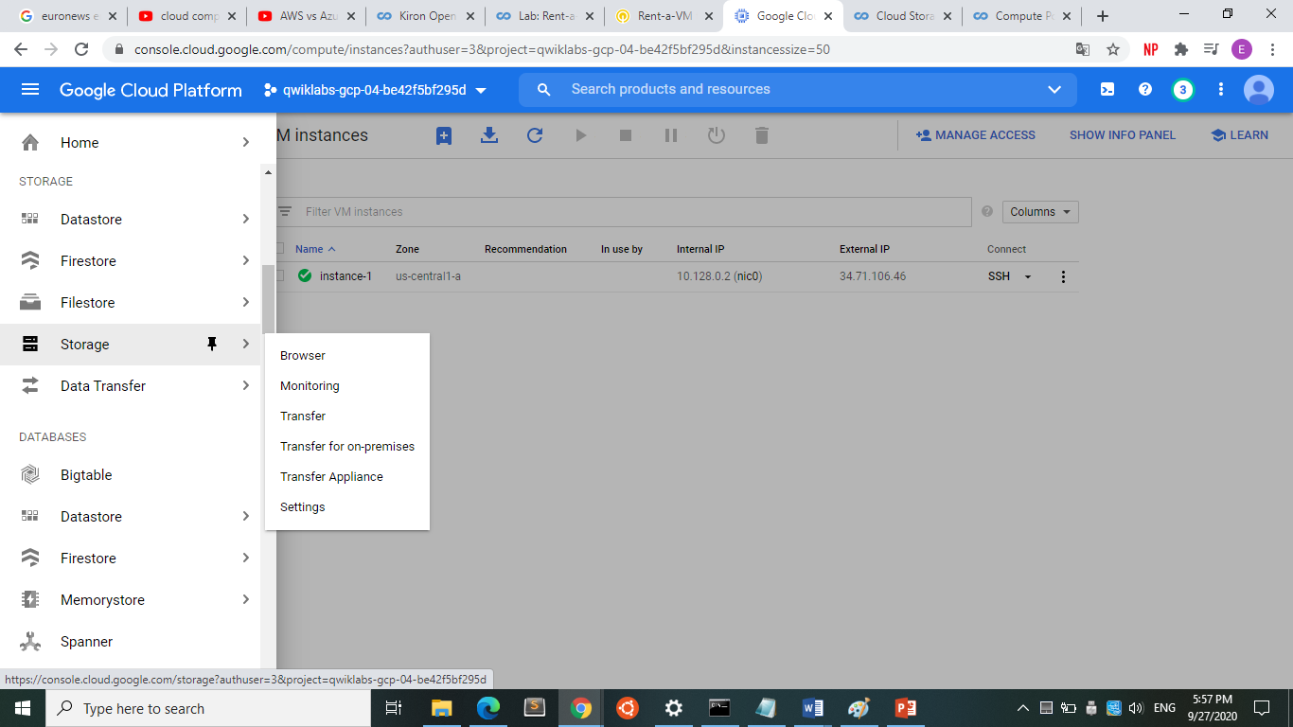
Notes:
Every application needs to store data.

Slide 13
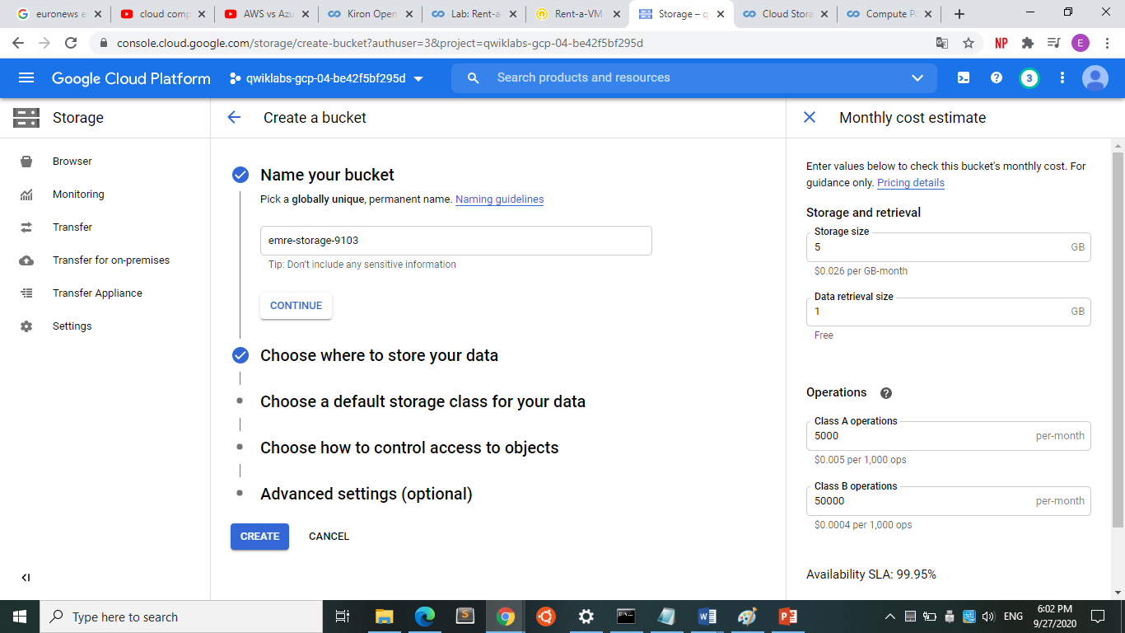

Slide 14
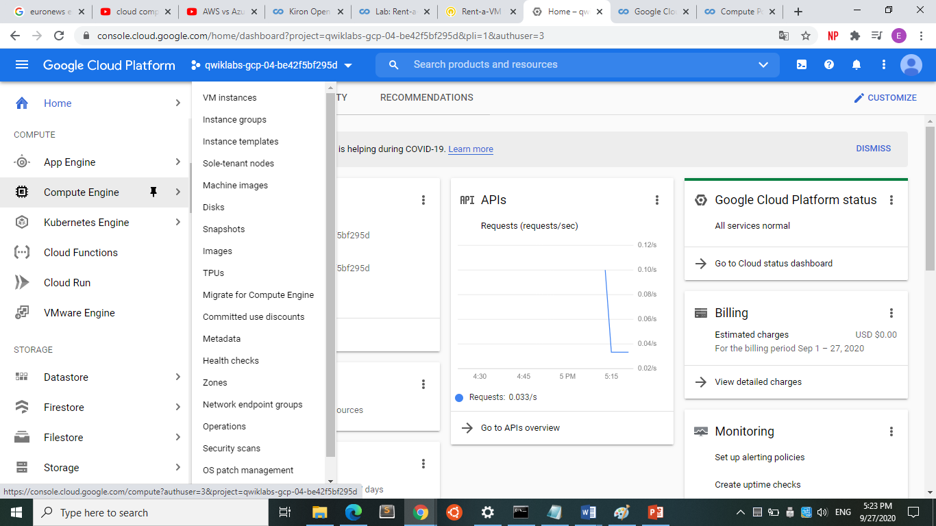
Notes:
A growing data organization will need lots of compute power to run big data jobs. Compute Engine lets you create and run virtual machines on Google infrastructure. Your VM can run Linux and Windows Server images provided by Google or customized versions of these images, and you can even import images for many of your physical servers. When you create a VM, pick a machine type which determines how much memory and how many virtual CPUs it has. These types range from very small to very large indeed. I will show you to create a virtual machine like our computers.

Slide 15
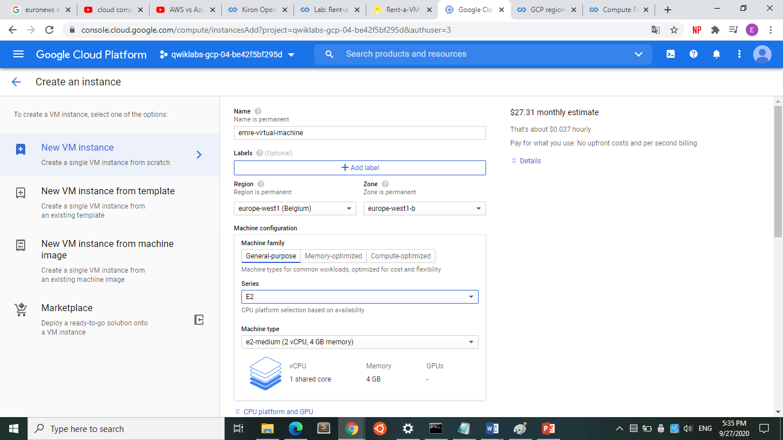
Notes:
You can choose what regions your GCP resources are in. All the zones within a region have fast network connectivity among them.
You can choose your machine type according to your need. You can choose strong machine like 4 CPU and 16 GB memory or less strong 2 CPU and 4 GB.
The bigger you choose, the more you pay. You pay only for what they use or reserve as they go. If you stop using resources, you stop paying.

Slide 16
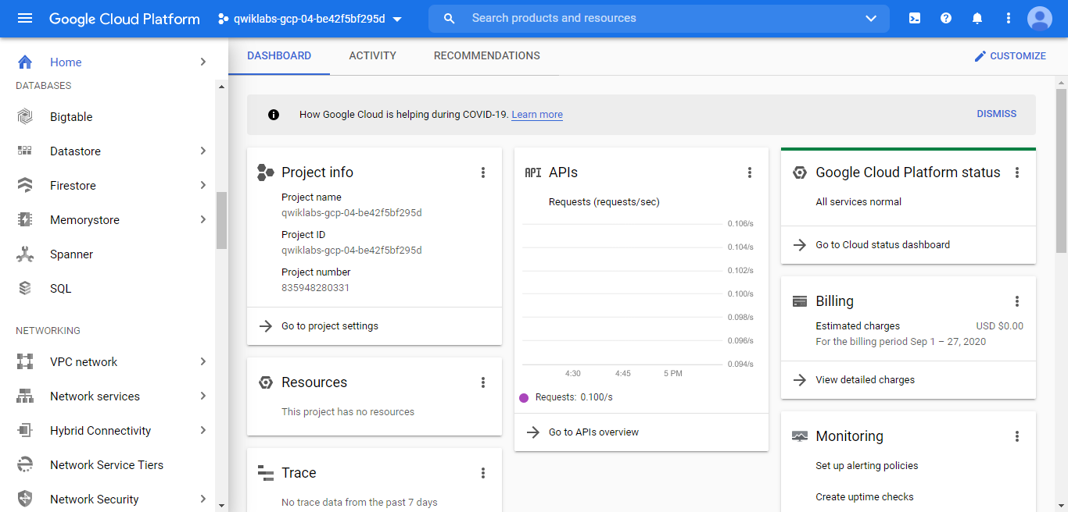
Notes:
you can want a company here with network services if everyone in your company works at home.

Slide 17
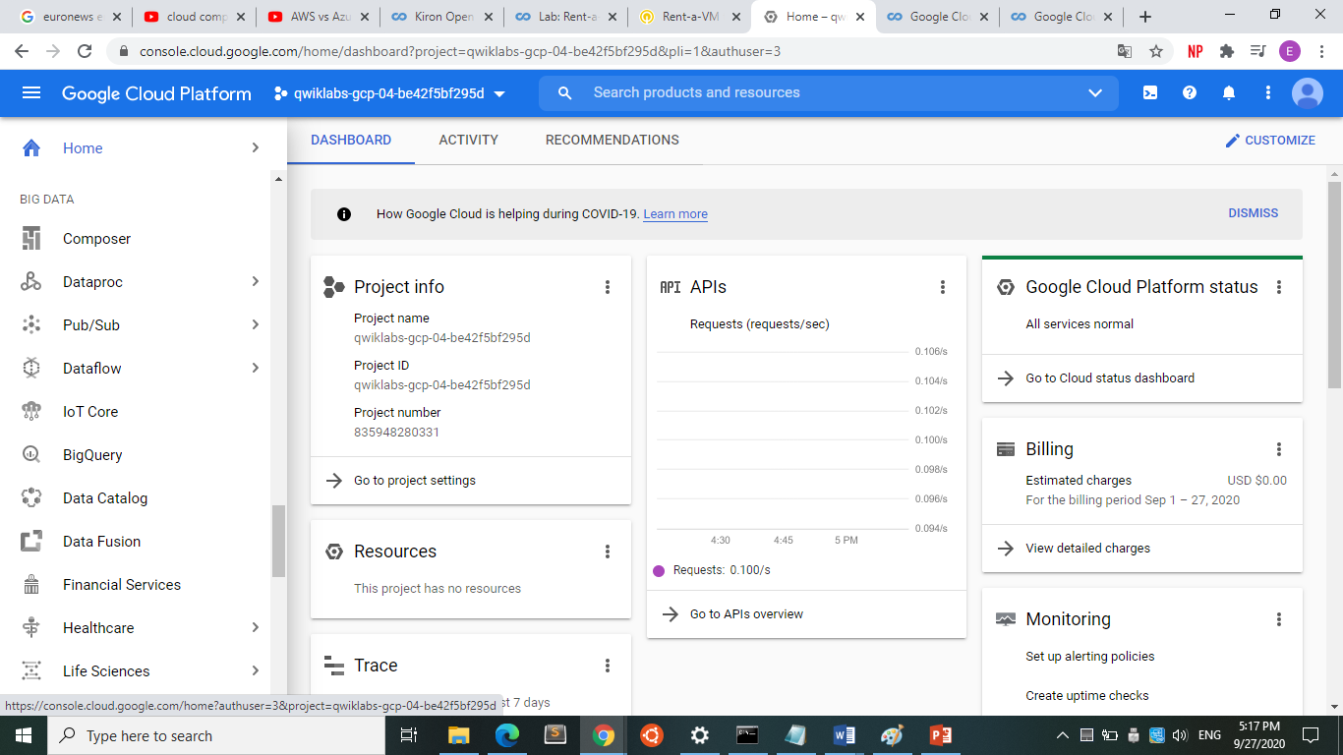
Notes:
Services of big data. I will tell you little big data history and GCP services about it.

Slide 18
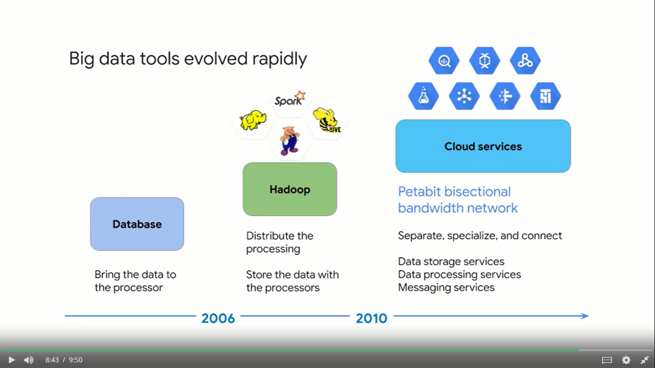
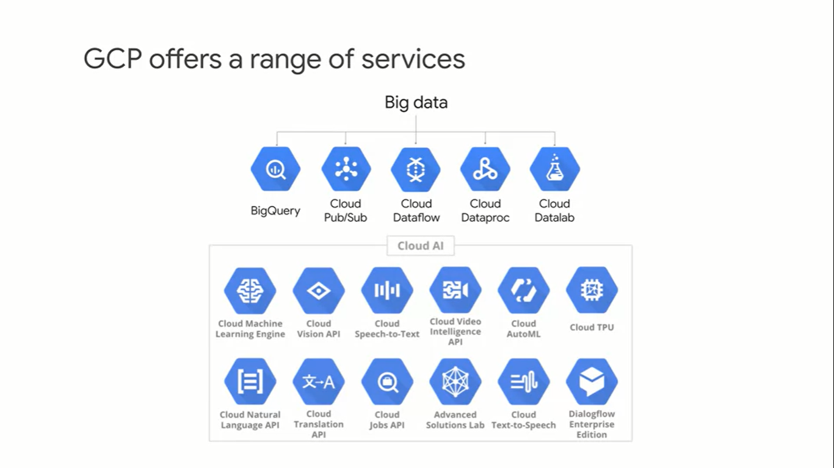
Notes:
Before 2006, big data meant big databases. Database design came from a time when storage was relatively cheap and processing was expensive. So it made sense to copy the data from its storage location to the processor to perform data processing, and then the result would be copied back to storage. Around 2006, distributed processing
of big data became practical with Hadoop. The idea behind Hadoop is to create a cluster of computers and leveraged distributed processing, HDFS. The Hadoop Distributed File System, stored the data on machines in the cluster, and MapReduce provided distributed processing of this data. Around 2010, BigQuery was released which was the first of many big data services developed by Google. Around 2015, Google launched Cloud Dataproc which provides a managed service for creating Hadoop and Spark clusters, and managing data processing workloads.

Slide 19
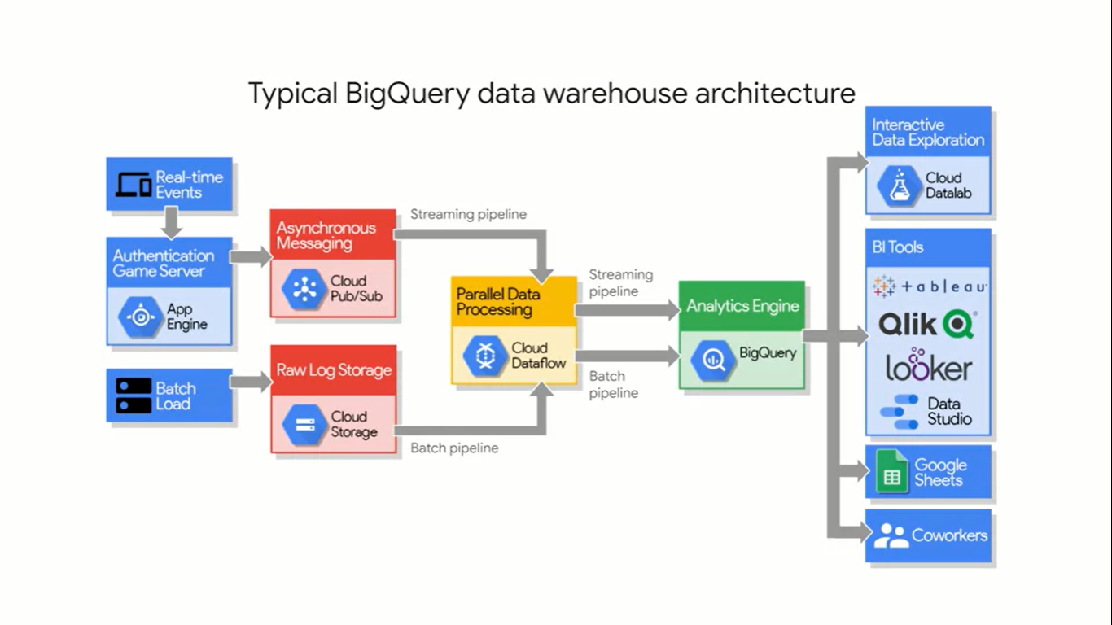
Notes:
We needed to make sure that we could process batch data and streaming data the same way. For example, we needed houses details in our scraping project.
Cloud dataproc help us transform from batch or data to tables like we stored data to csv file in our project. Cloud ML uses these tables for ML engineers, once your dataset is in BigQuery, you can easily call it from your IPython ML notebooks in the cloud with just a few commands.

Slide 20
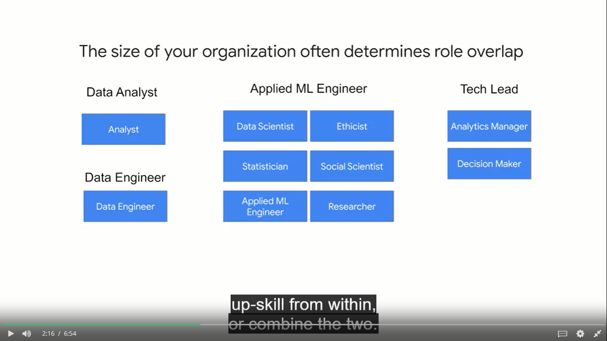
Notes:
You need data engineers to build the pipelines and get you clean data.
Decision makers, to decide how deep you want to invest in a data-driven opportunity
while weighing the benefits for the organization.
Analysts, to explore the data for insights and potential relationships that could be useful as features in a machine learning model.
Statisticians, to help make your data-inspired decisions become true data-driven decisions, with their added rigor.
Applied machine learning engineers, who have real-world experience building production machine learning models from the latest and best information and research by the researchers.
Data scientists, who have the mastery over analysis, statistics, and machine learning.
Analytics managers to lead the team.
Social scientists and ethicists to ensure that the quantitative impact is there for your project and, it's the right thing to do.
As I've written in a blog post on this subject, it's linked below, a single person might have a combination of these roles, but this depends on the size of your organization. Your team size is one of the biggest drivers in whether you should hire for a specific skill set, up-skill from within, or combine the two.

Slide 21
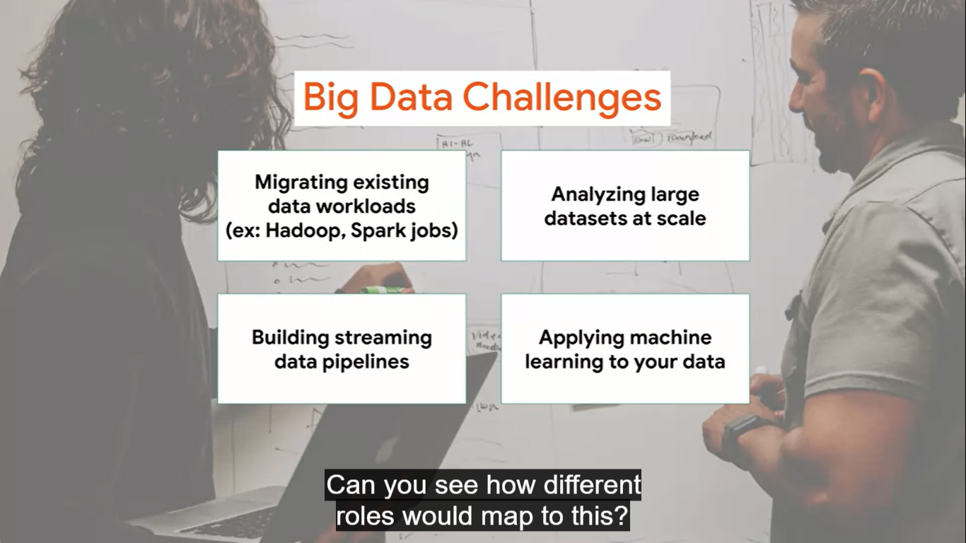

Slide 22
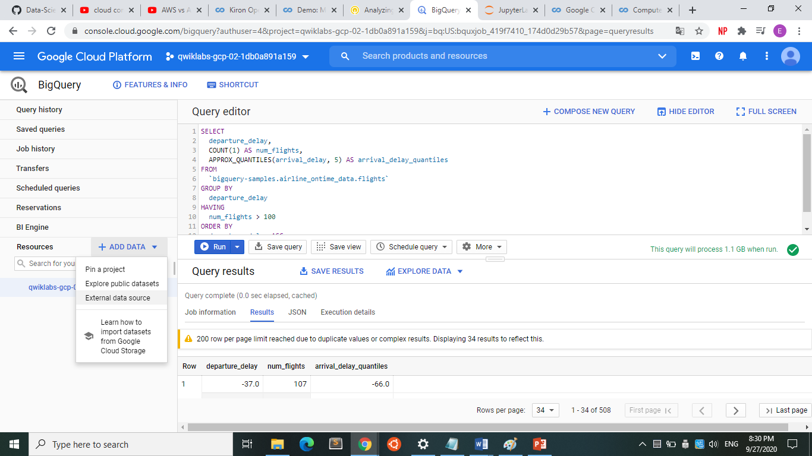
Notes:
BigQuery is designed to be an easy-to-use data warehouse. BigQuery as both a data warehouse and an Advanced Query Engine is foundational for your AI and ML workloads. It's common for data analysts, engineers, and data scientists to use BigQuery to store, transform, and then feed those large datasets directly into your ML models.

Slide 23
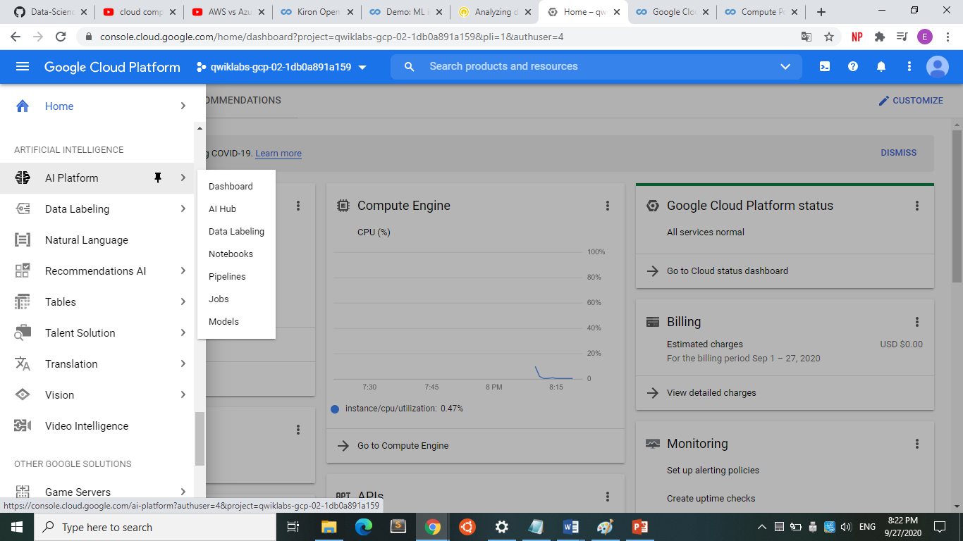

Slide 24
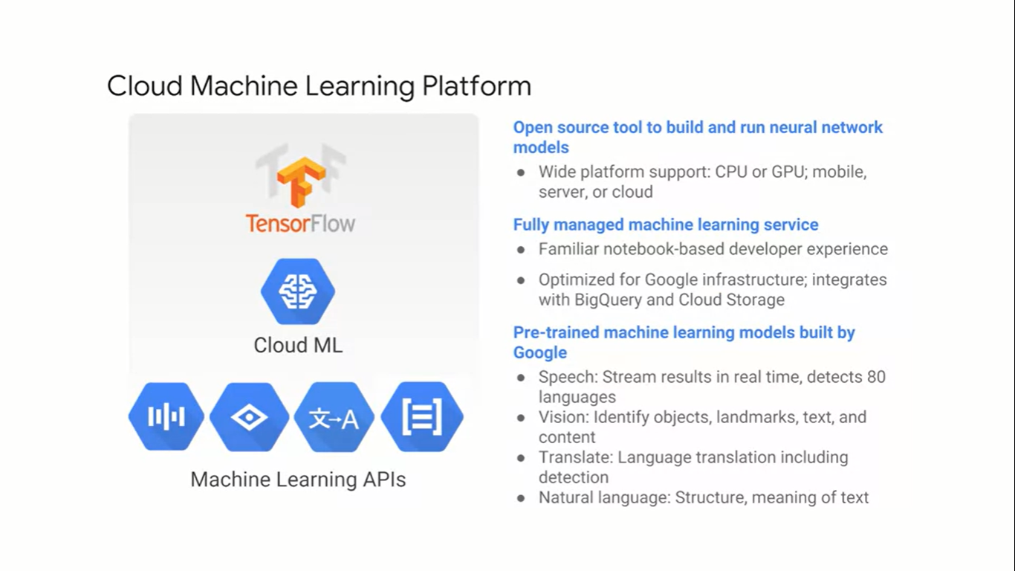
Notes:
Cloud Machine Learning Platform provides modern machine learning services with pre-trained models and a platform to generate your own tailored models. TensorFlow is an open source software library that's exceptionally well suited for machine learning applications like neural networks. You can run TensorFlow wherever you like but GCP is an ideal place for it because machine learning models need lots of on-demand compute resources and lots of training data.

Slide 25
